Slide 1
Structuring F# Programs with Abstract Data Types
Intermediate Topics in F# Programming, part 1

Slide 2
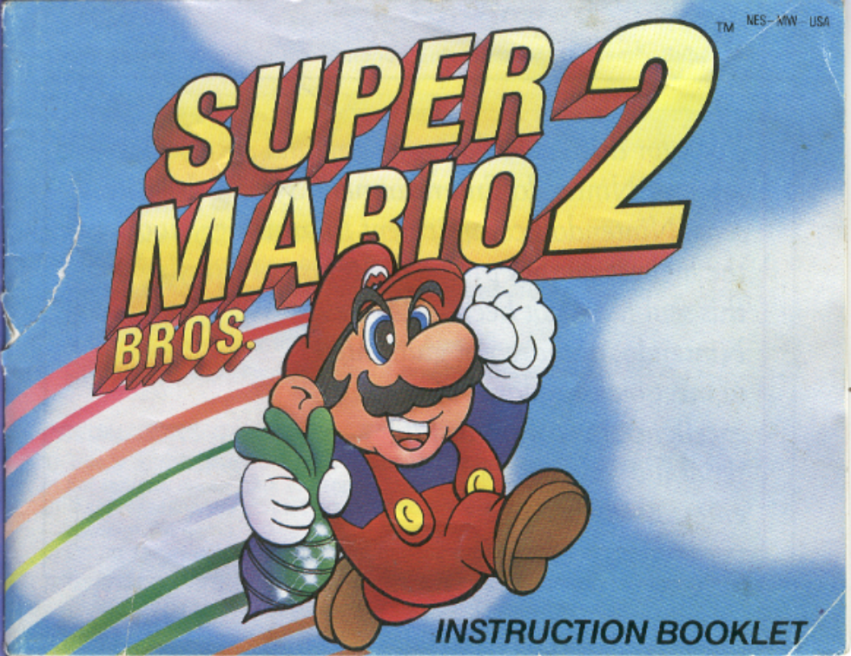
F#’s Missing Manual
F# doesn’t come with a manual for structuring programs
However, there are people who have already tread this ground
Today I want to propose a particularly lovely approach
Notes:
And there aren’t many widely adopted approaches for doing so. So most people are left on their own to figure it all out, and that creates difficulties.
Having done so myself in an environment conducive to extreme refactoring, I’ve come across a few good approaches
One that has worked surprisingly well for me across disparate and complex domains, including - Programming language implementation, game engine implementation, and scalable e-commerce backend implementation where I’ve had the chance to try it

Slide 3

An Aside - A Tale of Two Kingdoms
Steve Yegge has called OOP ‘the Kingdom of Nouns’.
With Functional Programming, we have the opportunity to rebel!
But have we overcorrected?
Notes:
In classic Java and C#, verbs (that is, functions) were second-class citizens that could travel only by being accompanied by a noun (that is, an object). Instead of passing a function to complete an action elsewhere, we had to create a ‘Strategy’ class that contained the function as an instance member, instantiate the class, pass around the instance, and then finally invoke the member function. What a royal pain!
We now have the choice to pack up our things and move to the Kingdom of Verbs! Here, the nouns are the second-class citizens! They lack the fundamental right to privacy, and thus all their affairs are exposed for the Verbs to inspect and transform at their whim! Sweet justice!
Just read

Slide 4

Why Not Move to the Kingdom of Verbs?
Many FP’rs actually do want to live in the Kingdom of Verbs
Anarchy in the F#!
Notes:
They do want all of their programs to be modeled as collections of processes and / or process abstractions. In the Kingdom of Verbs, all abstractions must be some form of mapping, or a generalization thereof. But I find this requirement to be intellectually inefficient in very many places. For example, is it more efficient to think of an F# Set as a collection of abstract processes, or as a single mathematical construct? And if the latter is true, shouldn’t our program’s artifacts reflect that?
I must be an anarchist, because I reject both kingdoms. I believe that nouns and verbs should be judged on their individual merits. If there is a job for a noun, I’ll employ them, and if there is a job for a verb, I’ll employ them too!

Slide 5

No Utopia
However, I am not an egalitarian!
Domain representations seem to be more stable than domain processes
Notes:
Nouns and verbs, though they should both be first-class citizens, are not created equally. Verbs, for example, are very good at specifying how to do something, and their abstracting type signature is very good at specifying what to do. Nouns, on the other hand, are very good at specifying how to represent something, and the abstracting type classification is very good at specifying what is being represented.
Because of this perceived stability, nouns tend to make up the majority of my program’s architectural building blocks. And there is an exemplary instance of a noun that I will describe now…

Slide 6
The F# Set – An Exemplary Noun!
Easy to use and simple to reason about
Functional in all the ways that matter
Implementation details are hidden from view
It composes both horizontally and vertically
(int Set * int Set) Set
Notes:
Its API is minimal, discoverable, and at proper granularity
All of its operations are referentially transparent. That is, you can replace any of its operation invocations with the returned value, and no one will know ☺
And therefore we can depend on the abstraction being upheld
Just read
By horizontal I mean side by side (the pair), and by vertical I mean containment (a set containing sets).

Slide 7
Set is Not Alone
There are several other types that have the same qualities as F# Sets –
Maps
Option
FSharpx.Queues
Haskell Primitives like Integer and Float
What is the nature common to all of these types?
They are all Abstract Data Types.
Notes:
Just read
Just read

Slide 8
What is an Abstract Data Type (ADT)?
A type whose internal representation is hidden from its consumers
A type whose functionality is accessible only through associated functions
And that’s it!
Notes:
Just read
Just read
As a bonus, F#’s syntax supports it very well, as we’ll see once we dig into an example later!

Slide 9
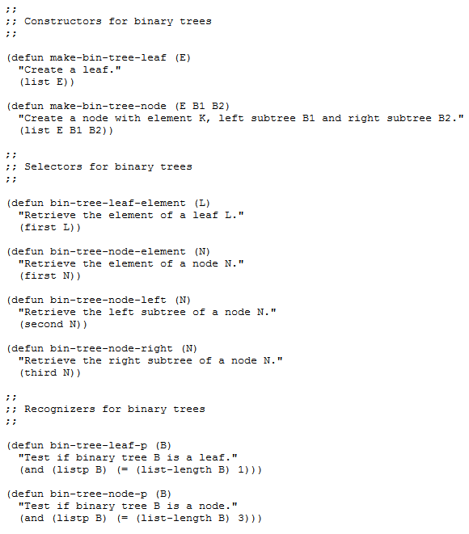
ADTs Have Been Around for Decades
From the early days of Lisp - http://www.cs.sfu.ca/CourseCentral/310/pwfong/Lisp/3/tutorial3.html
Notes:
Just explain

Slide 10
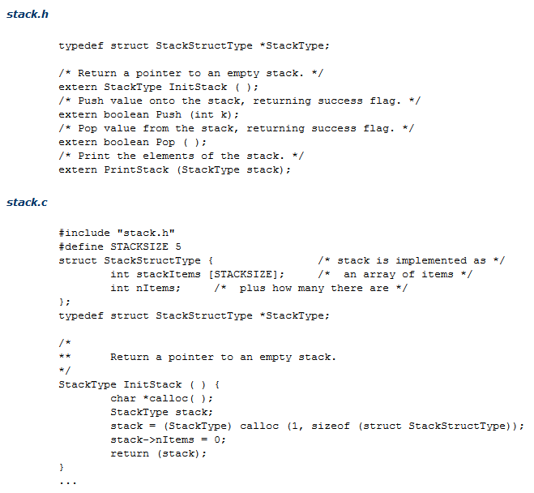
…and from the early days of C
http://inst.eecs.berkeley.edu/~selfpace/studyguide/9C.sg/Output/ADTs.in.C.html
Notes:
Just explain

Slide 11
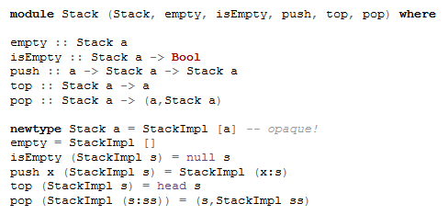
…and Still Going Strong in Newer Languages!
ADTs in Haskell - https://wiki.haskell.org/Abstract_data_type
Notes:
Just explain

Slide 12
Good Properties of ADTs
Ease of consumption
Ease of testing
Minimized coupling
Improved organization / coherency
Reduced duplication
Better parameterization
Abstraction closer to the business domain
Optional substitutability
Notes:
due to providing the simplest possible interface to users, stripped of irrelevant detail
due to forcing complex dependencies to be injected via its make function (a make function is the idiomatic name for the function that creates an ADT).
due to hiding internals from wanton engineers.
due to forcing functions that need internal access to be in the right place
due to providing a space to park new, related operations as they arise
due to providing convenient shelving for program parameters rather than being threaded into long call stacks
An entire business domain can be exposed as a public ADT
due to utilizing subtyping like how Set utilizes the Seq interface

Slide 13
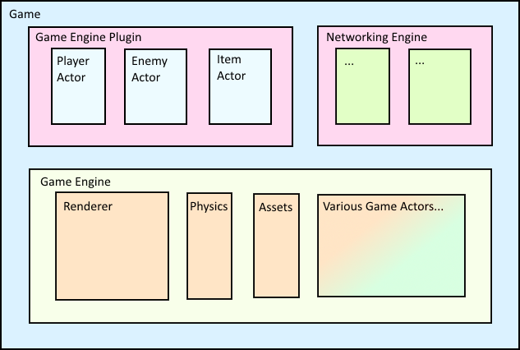
All That and Architectural Scalability!
Horizontal Composability + Vertical Stratification = Beautiful Architecture
Notes:
Explain the diagram, then - The full power of ADTs is realized when used as a program structuring tool. What’s most important about this diagram is its semi-fractal nature. ADTs are a sort of pattern that, when applied recursively to your program, should yield a principled, understandable, and stable program architecture.

Slide 14
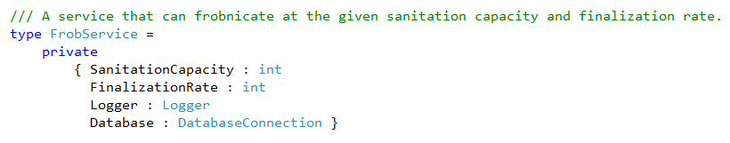
An Example ADT in F#...
The internal representation of an ADT is easy to define in F# –
Make a normal record with a private access modifier
Add the fields needed to parameterize its operations
Add fields for the dependencies it needs (which may also be ADTs!)
Notes:
Just read, but also point out things in image

Slide 15
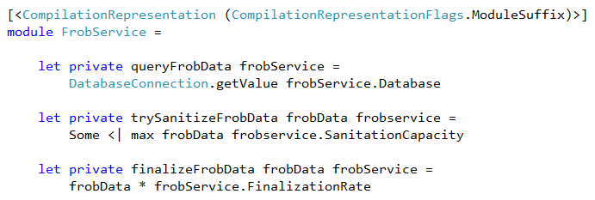
Now add private functions to implement its internal operations -
Notes:
Just explain

Slide 16
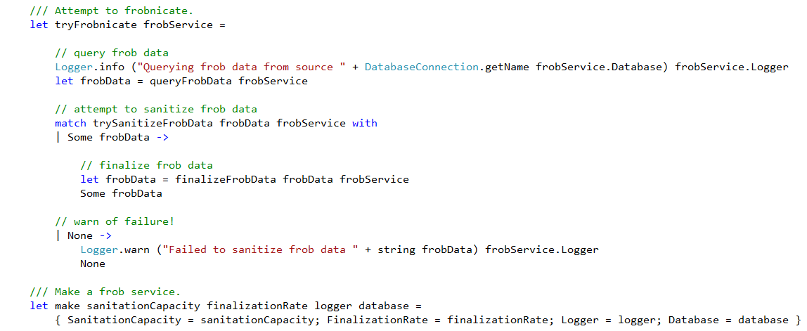
And below that, add the functions to impl. its public operations -
Notes:
Just explain

Slide 17
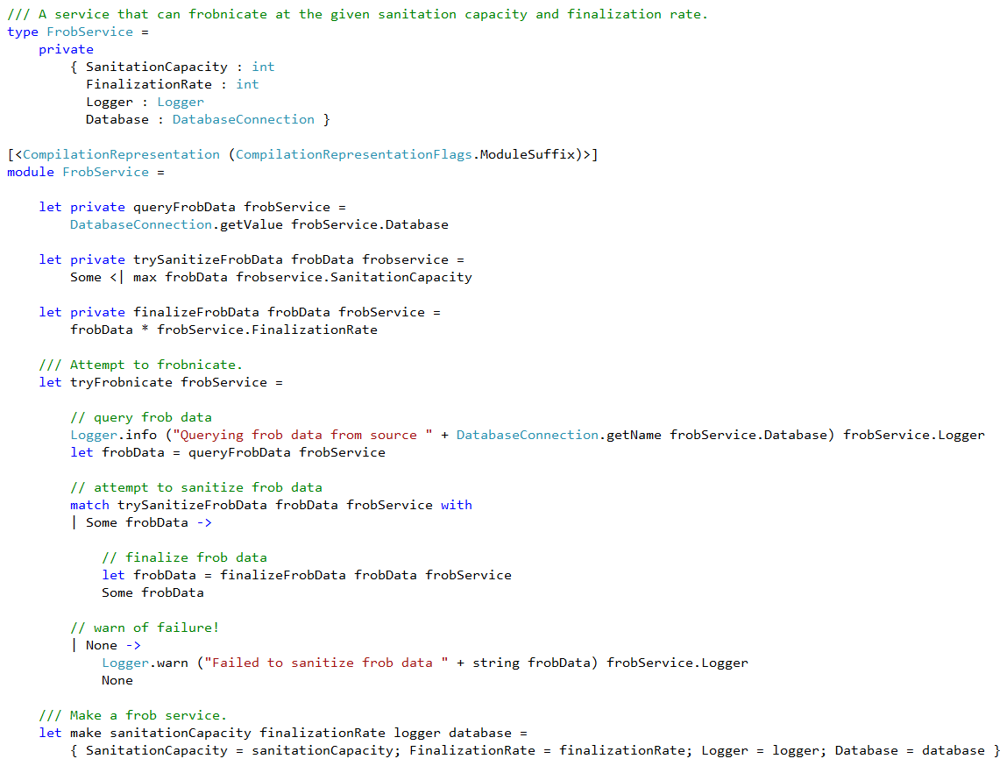
Notes:
And here’s the whole thing. Again, point out the parts.

Slide 18
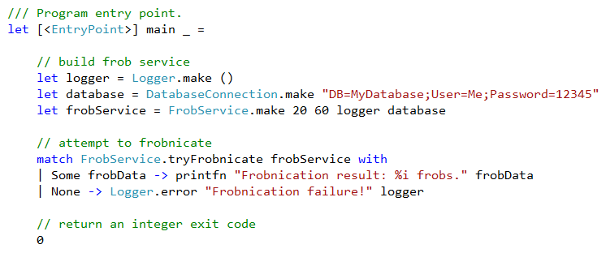
Example Usage of the ADT
Notes:
Here’s a sample F# program that consumes the FrobService ADT (a portion of which is elided) – Explain code

Slide 19

Only One Side of a Coin…
You may notice this ADT is not purely functional
They satisfy the Reader monad requirements (unlike objects)
let frobReader = reader { return! FrobService.tryFrobnicate }
I call these Impure ADTs
Notes:
Its only useful public operation is not referentially-transparent. That is, even if you provide its tryFrobnicate operation with the exact same parameters, you can get back a different result each time (such as when the data pulled from the database changes). But in its defense, it returns the result of each operation rather than affecting internal state unlike an object
Just read
But they’re only one side of the ADT coin!

Slide 20
Pure ADTs - the Other Side of the Coin
The F# Set type that we discussed earlier is a Pure ADT
Pure ADTs represent persistent (immutable) state through time
Their operations are generally referentially transparent
Pure ADTs are generally preferable to Impure ADTs
Pure ADT operations are a little different than that of Impure ADTs
Notes:
Just read
As a higher-level example, the state of an entire functional program can be represented as a single Pure ADT (which is also true for Impure ADTs)
And this referential transparency can be preserved by internally interfacing with its contained mutable dependencies via immutable message queues
But they can require hackery to work directly underneath imperative frameworks like WinForms, WPF, et al
The result of each operation is a potentially transformed version of the ADT (and sometimes additional data). Therefore, they satisfy the properties of the State monad rather than the Reader monad.

Slide 21
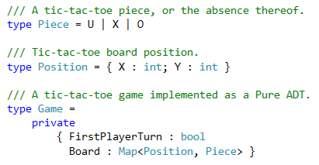
Pure ADT Example
Tic-Tac-Toe game represented entirely as a Pure ADT
Notes:
Here are just the types used to represent the game and its pieces. We’ll see the rest of the Game’s definition in the succeeding slides.

Slide 22
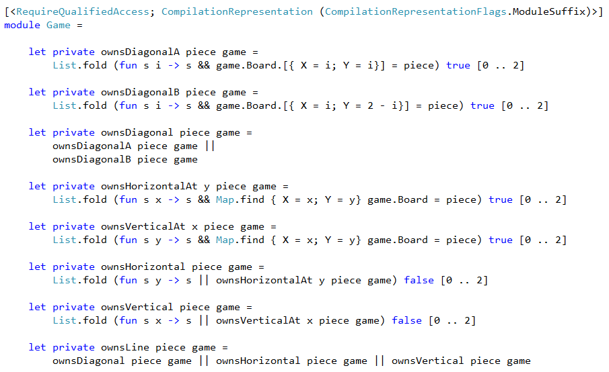
Pure ADT Example Private Functions
Notes:
Explain code

Slide 23
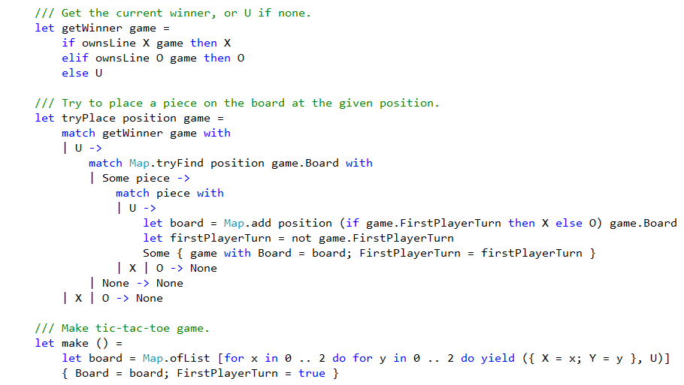
Pure ADT Example Public Functions
Notes:
Explain code

Slide 24
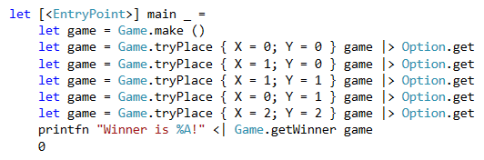
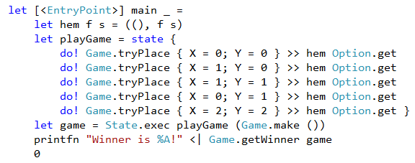
Pure ADT Example Usage
Usage –
Usage in State monad –
Notes:
Explain code, with emphasis on game pipelining and shadowing
Here’s the code when using the State monad. Being able to use your ADT from a State monad is very important, and is one of the reasons to avoid using object notation in F#.

Slide 25
Why Prefer Pure over Impure ADTs?
Pure ADTs are Truly Modular
The typical definition of modularity is wrong
Modularity is not code organization
Modularity is the delimitation of causation over a space of concerns
The typical definition of abstraction is also wrong
Pure ADTs give us what we need most
Notes:
Unlike Impure ADTs, their operations are referentially transparent, with no externally-observable side-effects to create causality leaks
Just read
Using classes, namespaces, or ironically F# modules alone won’t get it
The space of concern of modularity in programming is program semantics
Abstraction is not the mere hiding of implementation detail. Abstraction is rather the capturing of distilled conceptual essence.
That is, true modularity through referential transparency, and true abstraction through domain-level API provision.

Slide 26
Don’t Get Hung Up on Appearances!
Many people initially think F# ADTs look like OOP
Despite this, ADTs are not OOP
They are actually orthogonal. From Cook’s Paper ‘OOP vs. Abstract Data Types’ –
“The basic difference is in the mechanism used to achieve the abstraction barrier between a client and the data. In abstract data types, the primary mechanism is type abstraction, while in procedural data abstraction (sic – objects) it is procedural abstraction.” (http://www.cs.utexas.edu/users/wcook/papers/OOPvsADT/CookOOPvsADT90.pdf)
This orthogonality is why ADTs satisfy the Reader or State monad requirements while objects do not
Notes:
There are some superficial similarities, such as having a single context for every operation.
Just read
Just read

Slide 27

The Downsides of ADTs?
Well, there’s what I call ‘abstraction misses’
If abstraction misses are a problem, you have a few options
Notes:
From time to time you will notice a function that, by virtue of receiving an ADT, is getting access to more functionality than is necessary.
1) You could move only the needed (and hopefully coherent) sub-parts of the larger ADT into a new and smaller ADT, then pass that in instead. (Let’s call that the ‘extract ADT’ refactoring) 2) You could grab only the required fields of an ADT and pass them in individually. Or 3), you could just accept the abstraction miss as an inevitable trade-off of the approach. In my experience using this approach, I’ve never found it to be a problem in practice.

Slide 28

More Downsides of ADTs
Somewhat unfamiliar
Syntax is not perfect… yet
Notes:
For such a simple, powerful, and seemingly obvious technique, it’s rarely used for higher-level abstractions in F#. I just outright think this needs to change.
Fortunately, I’ve talked to Don and I think I’ve convinced him to enhance with F# even better syntactic support for ADTs. This will be provided by allowing the ADT’s let functions to be defined directly side the type definition rather than in a separate, specially-annotated module.

Slide 29
Refactoring Existing Code to use ADTs
Pick a record type whose internals are too exposed
Decide whether it should be an Impure or Pure ADT
Privatize the record’s fields by placing a private access modifier before its first brace like so -
type MyType private { … }
Move the existing functions (or portions of them) that access those newly-hidden fields into an appropriately attributed module with the same name as the type
Voila!
Notes:
Often the best candidates are records with mutable or ref fields
Pure is usually preferable, but is not practicable in all contexts
Just read
You have to use the somewhat unfortunately verbose [<CompilationRepresentation (CompilationRepresentationFlags.ModuleSuffix)>] attribute specification. After that, the compiler will show you all the places you need to refactor!
But remember, I said the process was simple – not always easy ☺

Slide 30

Summarizing – Nouns Considered Good for Architecture
We often build things out of things
ADTs are particularly good architectural building blocks!
Structuring programs with recursive ADTs has higher benefits
Notes:
My opinion, formed by experience in both the OO and functional paradigms has been that living in the Kingdom of Nouns impedes software composition due to an over-emphasis on objects, and that living in the Kingdom of Verbs impedes software architecture due to an over-emphasis on processes.
When you need the good properties of functional programming combined with the good properties of layered, composable architecture, ADTs are a good candidate.
ADTs are a sort of fractal pattern that can be applied recursively. When used with other good programming techniques, such a recursive should generally result in nice program architectures.

Slide 31
F# ADTs in the Real World
I’ve used ADTs to implement a purely functional game engine here - https://github.com/bryanedds/FPWorks
They are also used in an F# code library called ‘Prime’ that resides in the same repository.
I’m also using it at my place of work, Jet.com!

Slide 32
Questions / Contact Info
You can e-mail me at bryanedds@gmail.com
You can watch me publicly make an ass of myself here - https://twitter.com/bryanedds

